Slide 1
UNIT-III WIRELESS STANDARDS AND PROTOCOL STACK
WSN Standards- IEEE 802.15.4 Low rate WPAN, Zigbee, WirelessHART, ISA 100.11a, 6LoWPAN, IEEE802.15.3, Wibree, BLE, Zwave, ANT, Insteon, Wavenis, Protocol stack of WSNs, Cross layer protocol stack

Slide 2
WSNs Standards
The Industrial, Scientific and Medical (ISM) radio bands were first established in 1947 by the International Telecommunications Union (ITU) in Atlantic City.
The ISM bands are defined by the ITU-R in 5.138, 5.150, and 5.280 of the Radio Regulations (ITU 1947). Individual countries’ use of the bands designated in these sections may differ due to variations in national radio regulations.
ISM are radio bands (portions of the radio spectrum) reserved internationally for the use of radio frequency (RF) energy for industrial, scientific and medical purposes other than telecommunications .
Examples of applications in these bands include radio-frequency process heating, microwave ovens, and medical diathermy machines.
The powerful emissions of these devices can create electromagnetic interference and disrupt radio communication using the same frequency, so these devices were limited to certain bands of frequencies.

Slide 3
WSNs Standards
Wireless Sensor Network standards have been developed with a key design requirement for low power consumption. The standards define the functions and protocols necessary for sensor nodes to interface with a variety of networks.

Slide 4
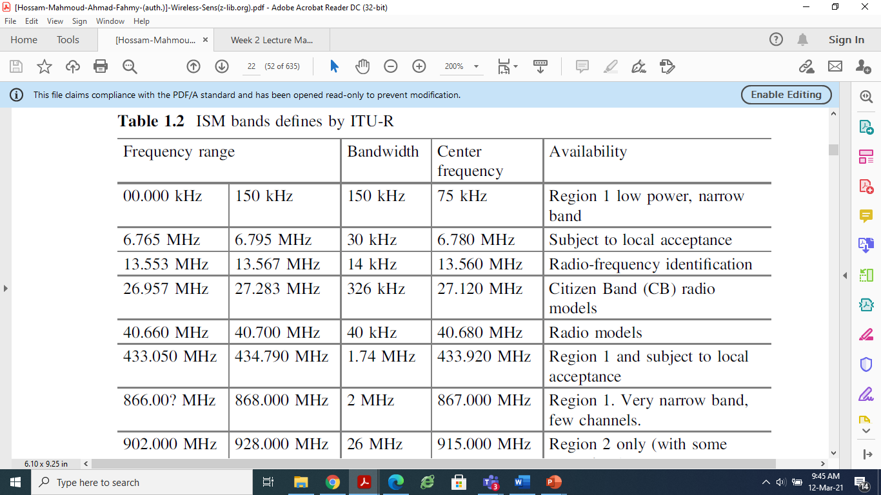

Slide 5
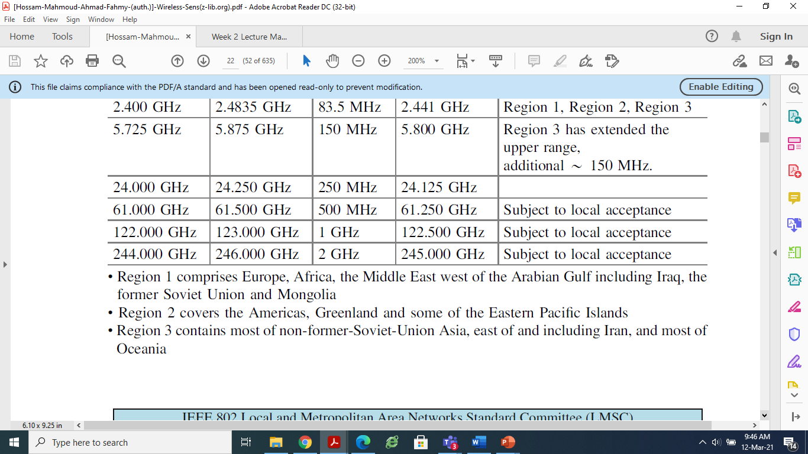

Slide 6
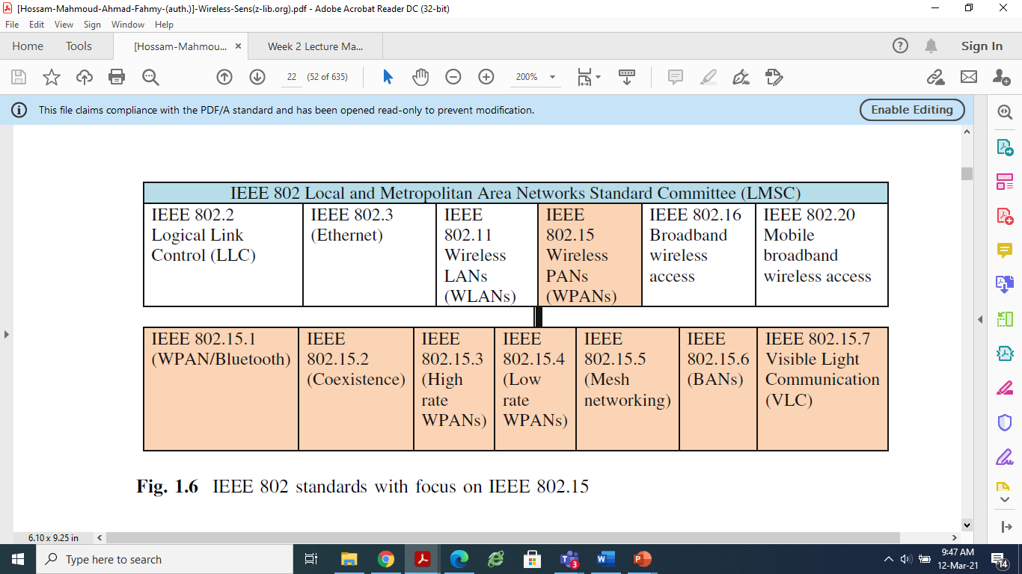

Slide 7
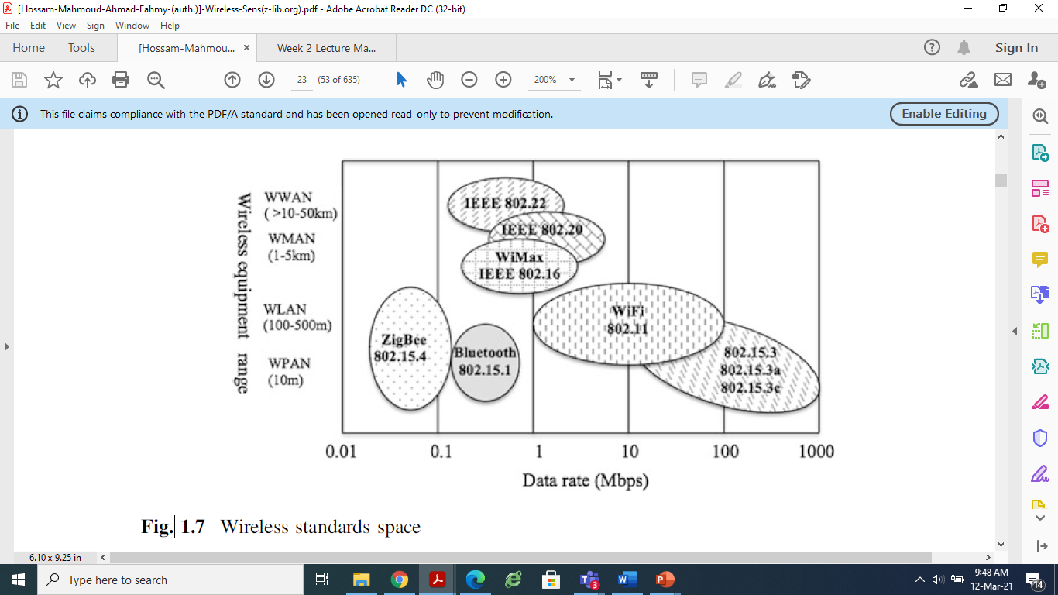
Different 802.15 standards are classified based on data rate and wireless equipment range

Slide 8
Wireless Sensor Network Protocol Stack
Several considerations must be taken when developing protocols for wireless sensor networks. Traditional thinking where the focus is on quality of service is somehow revised.
In WSNs, QoS is compromised to conserve energy and preserve the life of the network. Concern must be accorded at every level of the protocol stack to conserve energy, and to allow individual nodes to reconfigure the network and modify their set of tasks according to the resources available.
The protocol stack for WSNs consists of five standard protocol layers trimmed to satisfy typical sensors features, namely, application layer, transport layer, network layer, data-link layer, and physical layer.
These layers address network dynamics and energy efficiency. Functions such as localization, coverage, storage, synchronization, security, and data aggregation and compression are network services that enable proper sensors functioning.
Implementation of WSNs protocols at different layers in the protocol stack aims at minimizing energy consumption, and end-to-end Congestion control: end-to-end delay, and maintaining system efficiency. Traditional networking protocols are not designed to meet these WSNs requirements, hence, new energy-efficient protocols have been proposed for all layers of the protocol stack.
These protocols employ cross-layer optimization by supporting interactions across the protocol layers. Specifically, protocol state information at a particular layer is shared across all the layers to meet the specific requirements of the WSN.

Slide 9
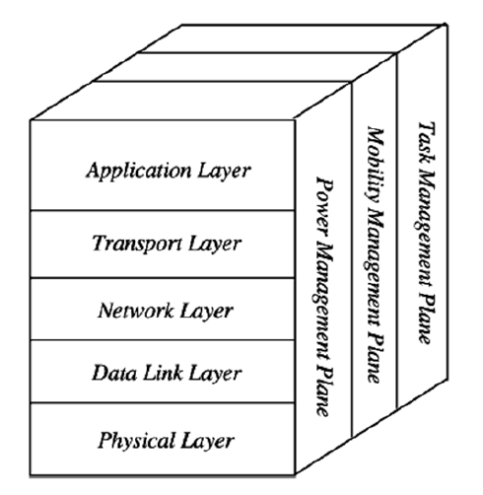
Wireless Sensor Network Protocol Stack

Slide 10
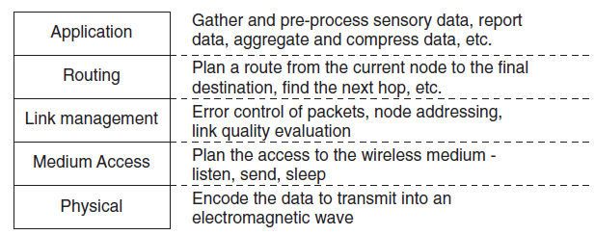
Sensor Network Communication Stack

Slide 11
Physical Layer
The physical layer is responsible for frequency selection, carrier frequency generation, signal detection, modulation and data encryption.
The 915 MHz ISM band has been widely suggested. ‘Ultra wideband (UWB)’ is an attractive candidate because of low transmission power, simple circuitry, use of pulse position modulation, resilience to multipath.
Modulation depends on transceiver and hardware design constraints, which aim for simplicity, low power consumption, and low cost per unit. Binary modulation schemes are simpler to implement and deemed to be more energy efficient.
The physical layer addresses the needs of simple but robust modulation, transmission and receiving techniques

Slide 12
Data Link Layer
The data link layer is responsible for multiplexing data streams, data frame detection, medium access and error control. It ensures reliable point-to-point and point-to-multipoint connections in a communication.
The MAC must establish communication links for data transfer in wireless multihop self organizing sensor network. This forms basic infrastructure.
MAC protocols must fairly and efficiently share communication resources between sensor nodes. Since there is noise and sensor nodes are mobile, MAC must be power-aware and able to minimize collision with neighbors’ broad cast.
The main features of MAC are periodic listen and sleep, collision and over hearing avoidance, and message passing.
The number of modes of operation of sensor node depending on states of processor, memory, transceiver, A/D converter must be power efficient.
‘Forward Error Correction (FEC)’is more feasible than ‘Automatic Repeat Request (ARQ)’.

Slide 13
The Network Layer
The network layer takes care of routing the data supplied by the transport layer.
The network layer is designed according to some principles.
Power efficiency is always an important consideration: Energy efficient routes are found like the route with maximum available power (PA); route with minimum energy consumption (ME); route with minimum hops (MH); etc.
Sensor networks are mostly data centric: The data is given only to the node which will perform task. This is called interest dissemination the sink broadcasts the data availability and sensor nodes broadcast advertisement. Sink waits for a request by interested nodes.
Data aggregation is useful only when it does not hinder the collaborative effort of the sensor nodes: data aggregation combines data from many nodes into a more compact form before forwarding it for processing.
An ideal sensor network has attribute-based addressing and location awareness: the user is interested in querying an attribute of the phenomena; rather than querying an individual node.
Other feature include clock synchronization, fault tolerance etc.

Slide 14
Transport Layer
The transport layer helps to maintain the flow of data if sensor network application requires it.
It is needed when a system is planned to be accessed through internet or other external networks.
The ‘Transmission control protocol (TCP)’ needs to be split into two parts. One connects sensor network to the other network like internet and the other connects the sink node to sensor nodes.
The addressing scheme here is not based on global addressing. It is based on attribute-based naming. Factors such as power consumption, scalability, etc. are taken care of.

Slide 15
Application Layer
Depending on sensing tasks, different types of application software can be built and used on application layer.
These protocols make hardware and software of lower layers transparent so that system administrators can edit settings.
Three such protocols are ‘Sensor management protocol (SMP)’ ‘Task assignment and data advertisement protocol (TADAP)’, ‘Sensor query and data dissemination protocol (SQDDP).
SMP provides software operations needed to perform tasks such as introducing rules related to data aggregation, attribute-based naming, clustering sensor nodes; time synchronization of sensor nodes; moving sensor nodes, etc.

Slide 16
Power, Mobility and Task Management Planes
When the power level of a sensor node is low, it broadcasts to its neighbors that it is low in power and cannot participate in routing messages. This is managed by power management plane.
The mobility management plane detects and registers movement of sensor nodes. The sensor nodes can keep track of who their neighbors are.
The task management plane balances and schedules sensing tasks given to a specific region. Not all sensor nodes perform sensing at same time.
Thus, the protocol stack combines power and routing awareness, integrates data with networking protocols, communicates power efficiently through wireless medium and promotes co-operative efforts of sensor nodes.

Slide 17
Cross Layer Protocol for WSN
WSNs have several restrictions such as limited energy supply, limited computing power, and limited bandwidth.
Energy efficiency has been considered one of the most important design challenges in WSN.
In layered approach the transfer overhead is more which consume more energy. Due to these restrictions, cross layer design is evolved for WSNs.
Cross-layer protocols do not follow the layered structure as a traditional OSI model follows.
In the crosslayered approach, the protocol stack is treated as a system and not an independent individual layer . The cross layer approach for WSNs is more effective than traditional approach.
Cross layer approach states that information of two or more layers are used to achieve an optial objective. The common goal of the cross layer approach in WSNs is to reduce energy consumption.

Slide 18
Cross Layer Protocol for WSN
Various cross layer designs approaches consider
1) New interface for information exchange between non adjacent layers
2) Merging of adjacent layers for joint functionality and reduced overhead.
3) Design coupling between layers
4) Vertical calibration between layers

Slide 19
Cross Layer Protocol for WSN
The central idea of cross-layer design is that by jointly optimizing the control and exchange of information over two or more layers, significant performance improvements can be achieved by exploiting the interactions between various layers of the protocol stack.
However, the drawback to such a design is the potential to destroy modularity of overall system

Slide 20
IEEE 802.15.4 low rate WPANs
IEEE 802.15.4 is the proposed standard for low rate wireless personal area networks (LR-WPAN’s) with focus on enabling WSNs (Gutierrez et al. 2001; Callaway et al. 2002; Howitt and Gutierrez 2003).
IEEE 802.15.4 focuses on low cost of deployment, low complexity, and low power consumption; it is designed for wireless sensor applications that require short range communication to maximize battery life.
WSNs applications using IEEE 802.15.4 include residential, industrial, and environment monitoring, control and automation.

Slide 21
IEEE 802.15.4 low rate WPANs
IEEE 802.15.4 devices are designed to follow the physical and data-link layer protocols.
The physical layer supports 868/915 MHz low bands and 2.4 GHz high bands.
The MAC layer controls access to the radio channel using the CSMA/CA mechanism.
The MAC layer is also responsible for validating frames, frame delivery, network interface, network synchronization, device association, and secure services.

Slide 22
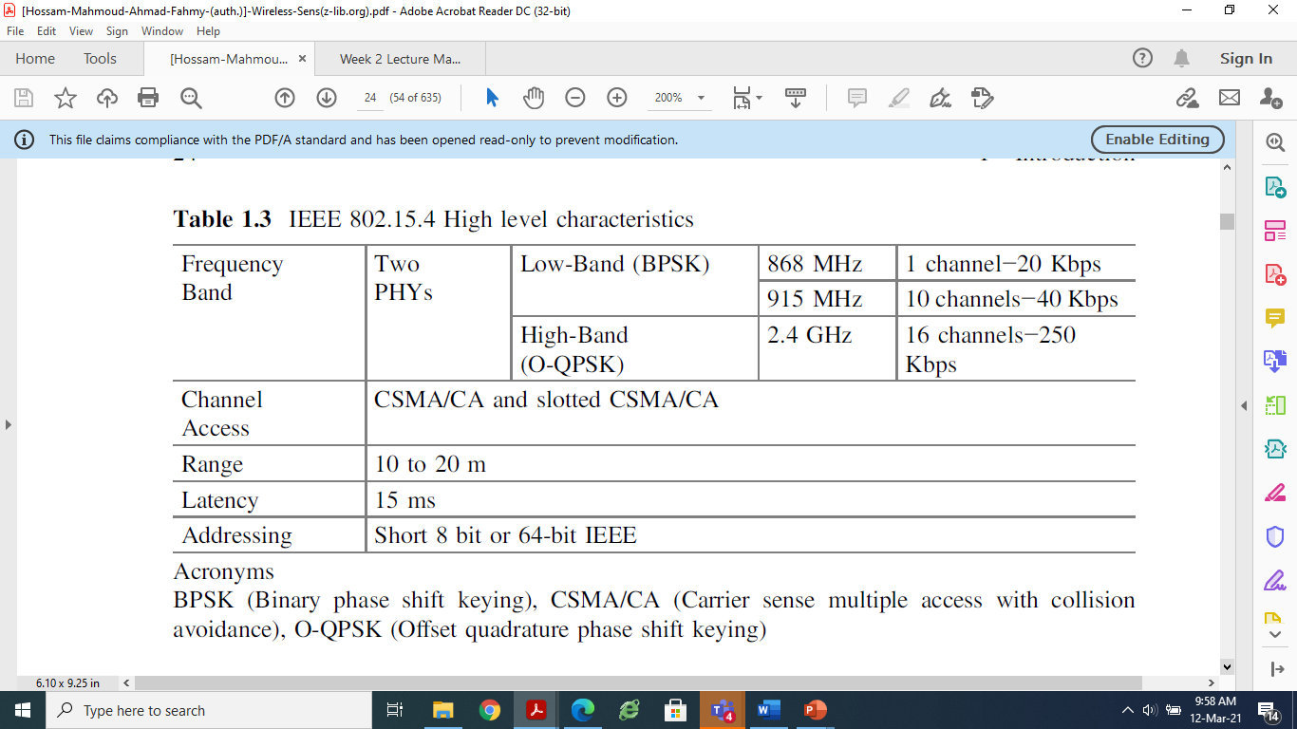
IEEE 802.15.4 low rate WPANs

Slide 23
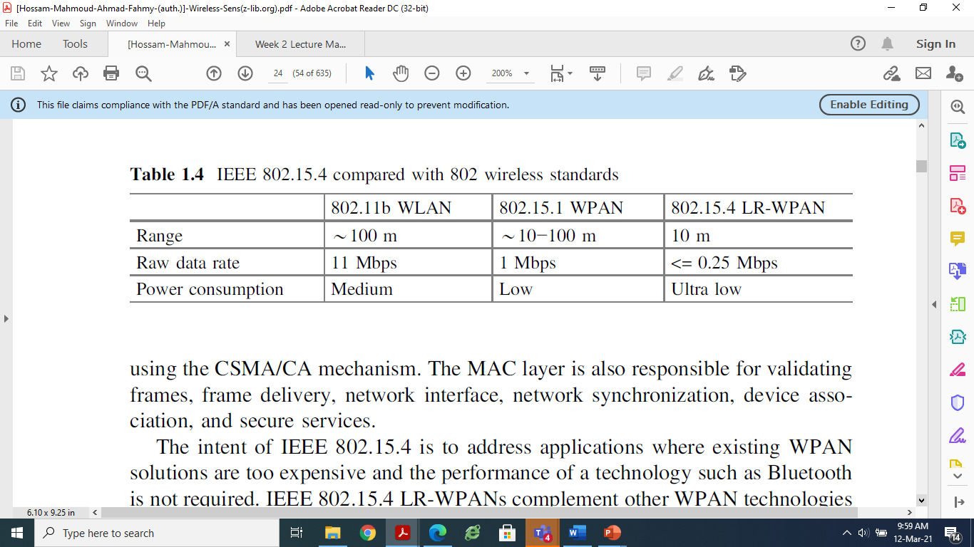
IEEE 802.15.4 low rate WPANs

Slide 24
The intent of IEEE 802.15.4 is to address applications where existing WPAN solutions are too expensive and the performance of a technology such as Bluetooth is not required.
IEEE 802.15.4 LR-WPANs complement other WPAN technologies by providing very low power consumption capabilities at very low cost, thus enabling applications that were previously impractical.

Slide 25
As previously stated, like all IEEE 802 standards, the IEEE 802.15.4 standard encompasses only PHY layer and portions of the data link layer (DLL).
Higher layer protocols are at the discretion of the individual applications utilized in an in-home network environment.
In traditional wired networks, the network layer is responsible for topology construction and maintenance, as well as naming and binding services, which incorporate the necessary tasks of addressing, routing, and security.
The same services exist for wireless in-home networks, but are far more challenging to implement because of the premium placed on energy conservation.
In fact, it is important for any network layer implementation built on the already energy conscious IEEE 802.15.4 standard to be equally conservative.
Network layers built on the standard must be self-organizing and self-maintaining, to minimize total cost to the consumer user.

Slide 26
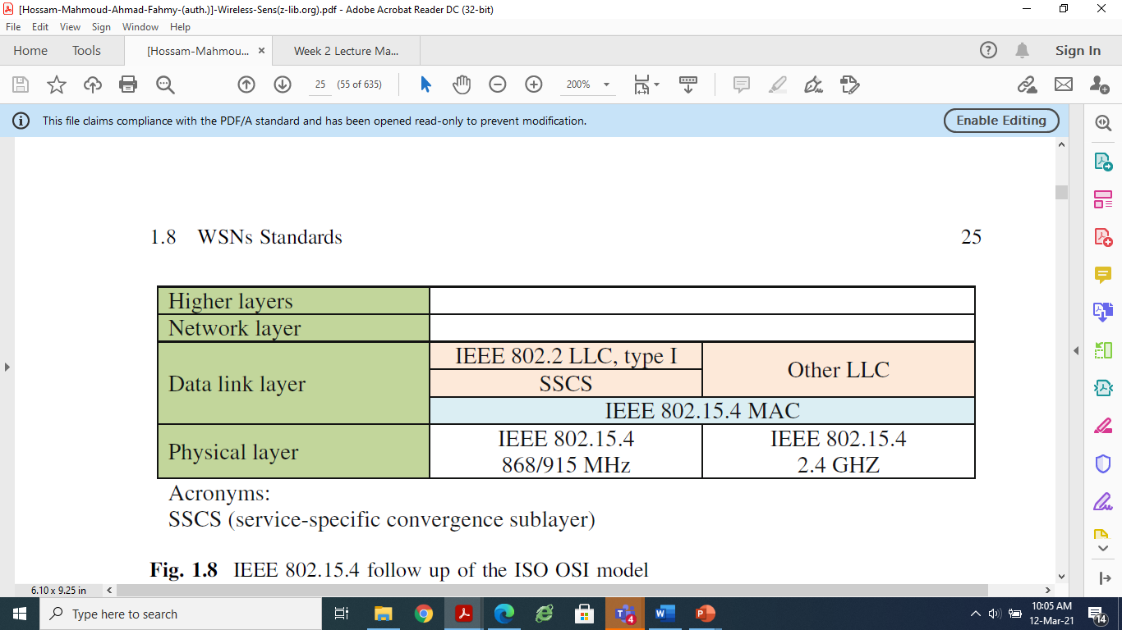
Protocol Stake of IEEE 802.15.4

Slide 27
Protocol Stake of IEEE 802.15.4
The IEEE 802 standard splits the DLL into two sublayers, the MAC and logical link control (LLC) sublayers.
The LLC is standardized in 802.2 and is common among the 802 standards such as 802.3, 802.11, and 802.15.1, while the MAC sublayer is closer to the hardware and may vary with the physical layer implementation.
The features of the IEEE 802.15.4 MAC are association and disassociation, acknowledged frame delivery, channel access mechanism, frame validation, guaranteed time slot management, and beacon management.

Slide 28
Topology
The IEEE 802.15.4 standard allows the formation of the star and peer-to-peer topology for communication between network devices
In the star topology, the communication is performed between network devices and a single central controller, called the PAN coordinator. A network device is either the initiation point or the termination point for network communications. The PAN coordinator is in charge of managing all the star PAN functionality.
In the peer-to-peer topology, every network device can communicate with any other within its range. This topology also contains a PAN coordinator, which acts as the root of the network. Peer-to-peer topology allows more complex network formations to be implemented; e.g., ad hoc and self-configuring networks. The routing mechanisms required for multi-hopping are part of the network layer and are therefore, not in the scope of IEEE 802.15.4.

Slide 29
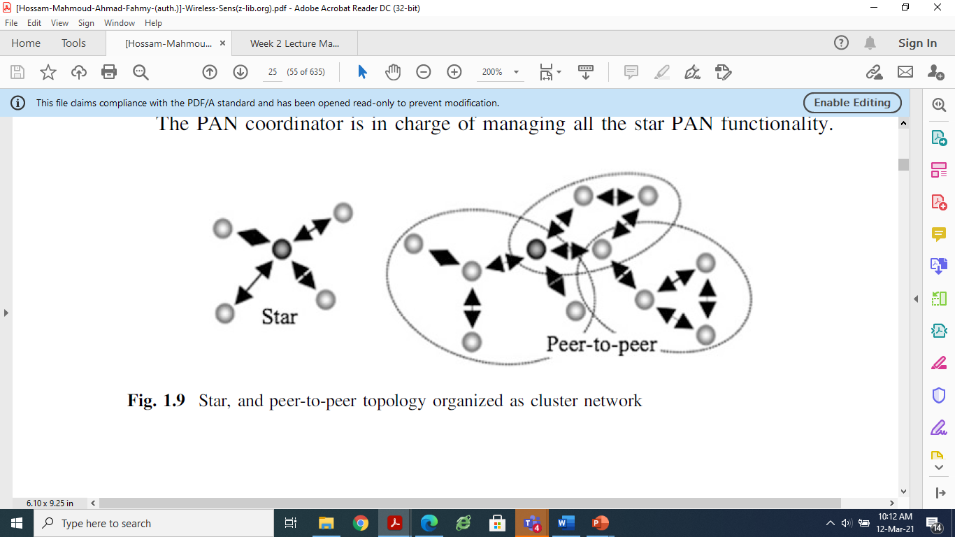
Topology

Slide 30
ZigBee
The ZigBee standard was publicly available as of June 2005 (ZigBee Alliance 2013), it defines the higher layer communication protocols built on the IEEE 802.15.4 standards for LR-PANs.
ZigBee got its name from the way bees zig and zag while tracking between flowers and relaying information to other bees about where to find resources.
ZigBee is a simple, low cost, and low power wireless communication technology used in embedded applications.
ZigBee devices use very little power and can operate on a cell battery for many years.
ZigBee has been introduced by IEEE with IEEE 802.15.4 standard and the ZigBee Alliance to provide the first general standard for such applications.

Slide 31
ZigBee
ZigBee is built on the robust radio (PHY) and medium access control (MAC) communication layers defined by the IEEE 802.15.4 standard for LR-WPANs.
On the higher layer, ZigBee defines mesh, star and cluster tree network topologies with data security features and interoperable application profiles

Slide 32
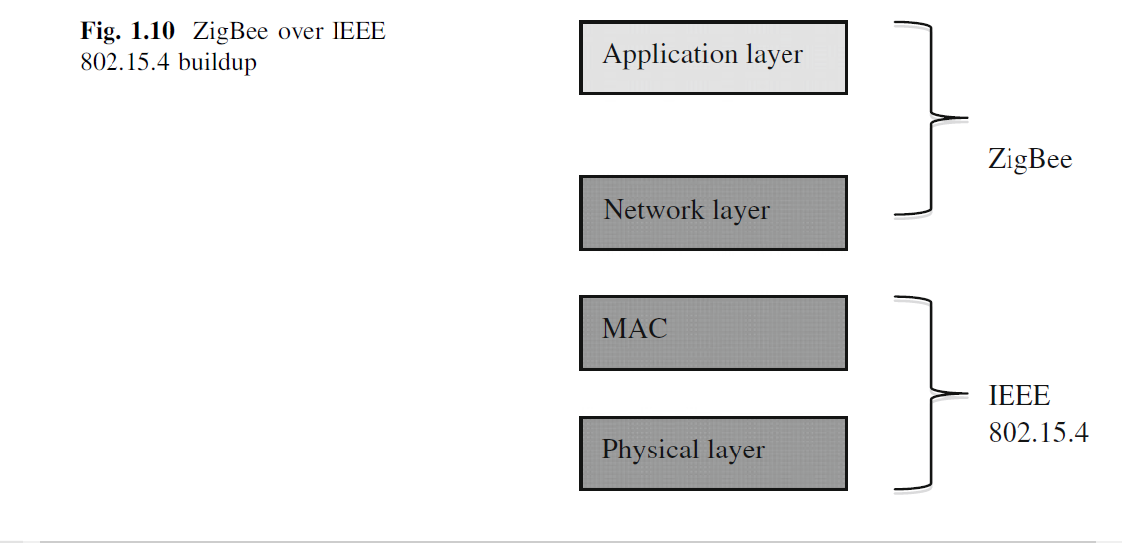
ZigBee

Slide 33
ZigBee Network Model
ZigBee coordinator, it initiates network formation, stores information, and can bridge networks together.
• ZigBee routers, they link groups of devices together and provide multi-hop communication across devices.
• ZigBee end device, it consists of the sensors, actuators, and controllers that collects data and communicates only with the router or the coordinator.

Slide 34
ZigBee Network
In general, ZigBee specifies three roles for a device in a ZigBee network:
ZigBee Coordinator
ZigBee Router
ZigBee End Device

Slide 35
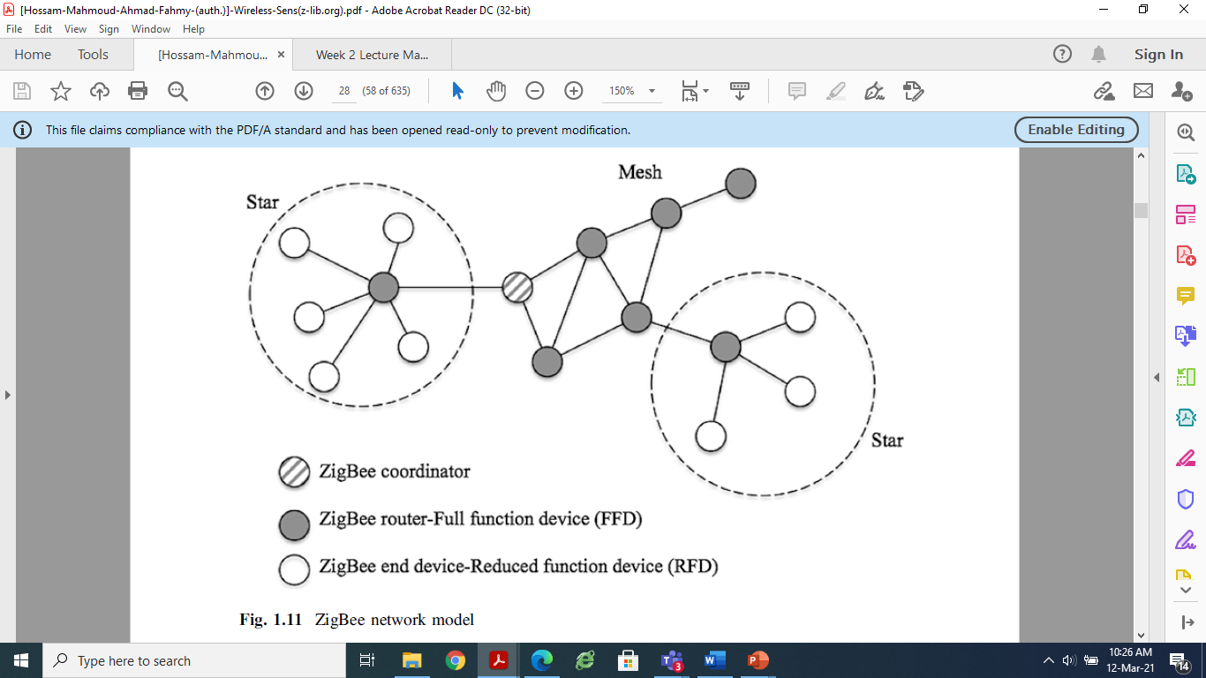
ZigBee Network Model

Slide 36
ZigBee
ZigBee is the only standards-based technology designed to address the unique needs of low-cost, low-power WSNs for remote monitoring, home control, and building automation network applications in the industrial and consumer markets.
For commercial success one needs a standards-based wireless technology that has performance characteristics that closely meet the requirements for reliability, security, low power, and low cost.
The IEEE 802.15 Task Group 4 was chartered to investigate a low data-rate solution with multi month to multiyear battery life and very low complexity.
The standard is intended to operate in an unlicensed international frequency band.

Slide 37
Potential applications for this standard are home automation, wireless sensors, interactive toys, smart badges, and remote controls.
This standards-based interoperable wireless technology is optimized to address the specific needs of low-data-rate wireless control and sensor-based networks.
The ZigBee Alliance ratified the first ZigBee specification in 2004, making the development and deployment of power-efficient, cost-effective, low-data-rate monitoring,
control, and sensing networks a reality.
ZigBee/IEEE 802.15.4 is expected to become the leading wireless technology for a majority of users, ranging from building automation to industrial and residential applications.

Slide 38
ZigBee Coordinator
ZigBee Coordinator is what we have called the sink so far.
It is the main node in the network and it is only one.
It collects all of the information and also serves as security coordinator (key repository).
With some variations of Zigbee, it is possible to also work without the coordinator, but having one is more usual.
This node is the most powerful in the network and requires the most energy and memory resources.

Slide 39
ZigBee Router
ZigBee Router is a device, which can sense data, and also forward data from other nodes.
It needs less energy and memory than the coordinator.

Slide 40
ZigBee End Device
ZigBee End Device is a device, which can only sense phenomena and send them to its parent (a router or a coordinator).
It cannot serve as a forwarder, which allows it to sleep most of the time without caring about any other devices in the network.

Slide 41
Operating Techniques of ZigBee
Each device in the ZigBee network needs to be assigned with a role, which cannot be changed during runtime.
There are two possible modes of operation for the routers: beacon-less and beacon-based.
In beacon-less ZigBee, the routers use the normal CSMA/CA MAC protocol.
This allows the end devices to sleep as much as they can or need, but forces the routers to stay awake continuously.
With beacon-based ZigBee, the routers use a TDMA style to send out beacons to inform their neighbors when they are awake.
This allows them to use a duty cycle because nodes need to be awake only when their neighbors send out beacons.
The length of the duty cycle depends on the data rate of the network and is configured before deployment.

Slide 42
Wireless Sensor Network Protocol Stack
The goal of WSN engineers is to develop a cost-effective standards-based wireless networking solution that supports low-to medium data rates, has low power consumption, and guarantees security and reliability.
The position of sensor nodes does not have to be predetermined, allowing random deployment in inaccessible terrains or dynamic situations.
This also means that sensor network protocols and algorithms must possess self-organizing capabilities.
For military and/or national security applications, sensor devices must be amendable to rapid deployment, the deployment must be supportable in an ad hoc fashion.

Slide 43
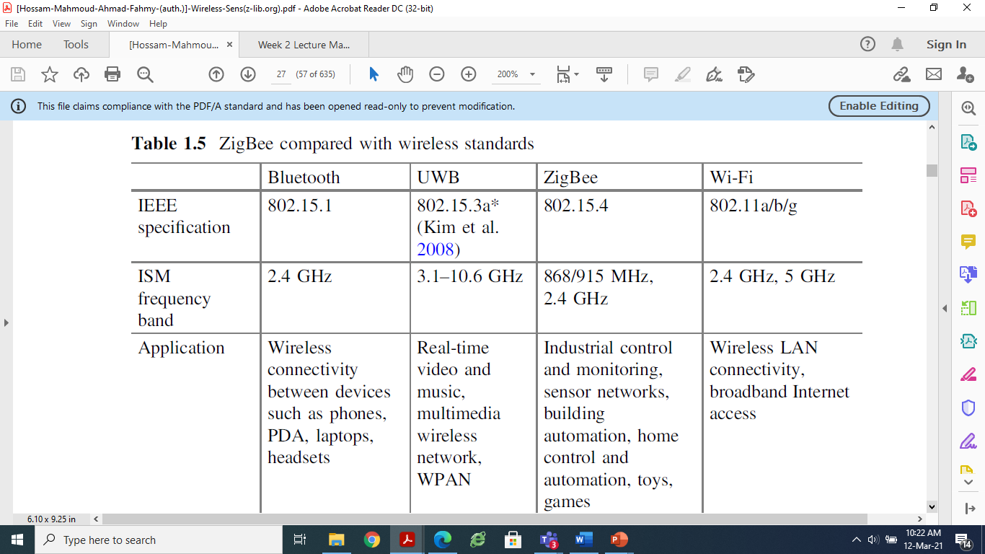

Slide 44
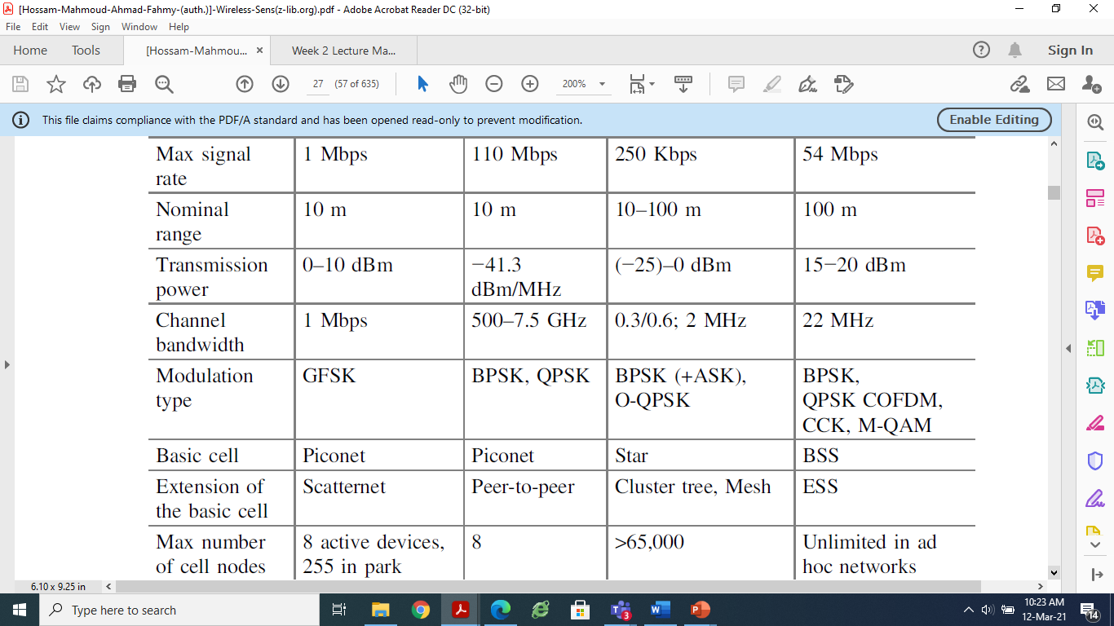

Slide 45
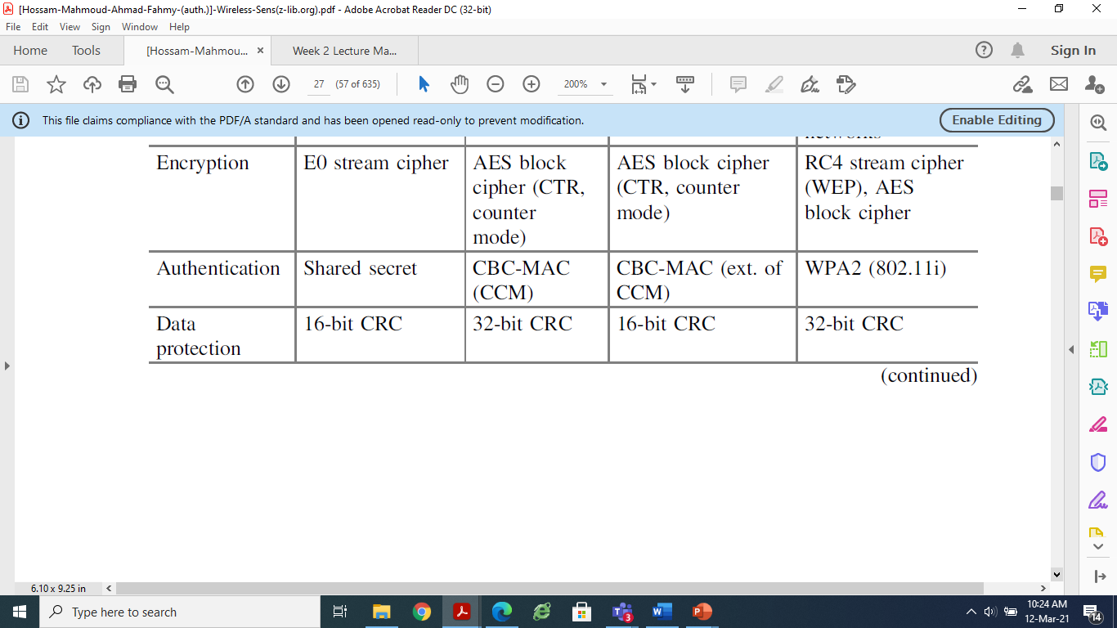

Slide 46
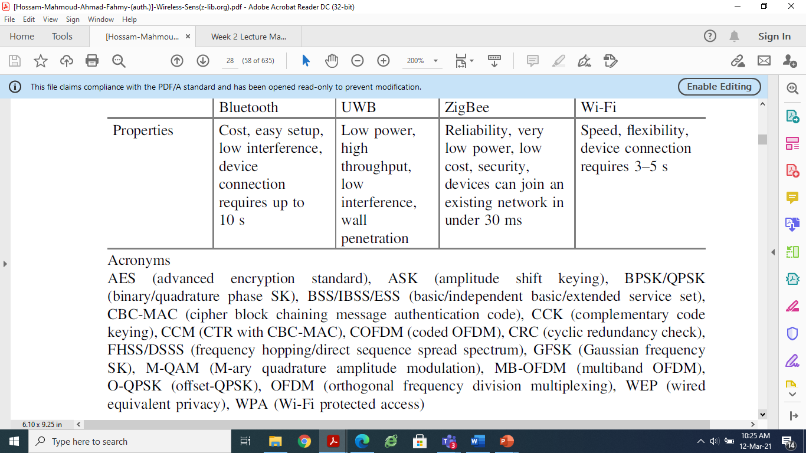

Slide 47
WirelessHART
WirelessHART was released in September 2007 (Kim et al. 2008; Song et al. 2008).
The WirelessHART standard provides a wireless network communication protocol for process measurement and control applications, it is based on IEEE 802.15.4 for low power 2.4 GHz operation.
WirelessHART is compatible with all existing devices, tools, and systems, it is reliable, secure, and energy efficient, and supports mesh networking, channel hopping, and time-synchronized messaging.
Network communication is secure with encryption, verification, authentication, and key management.
Power management options enable the wireless devices to be more energy efficient.
WirelessHART is designed to support mesh, star, and combined network topologies.

Slide 48
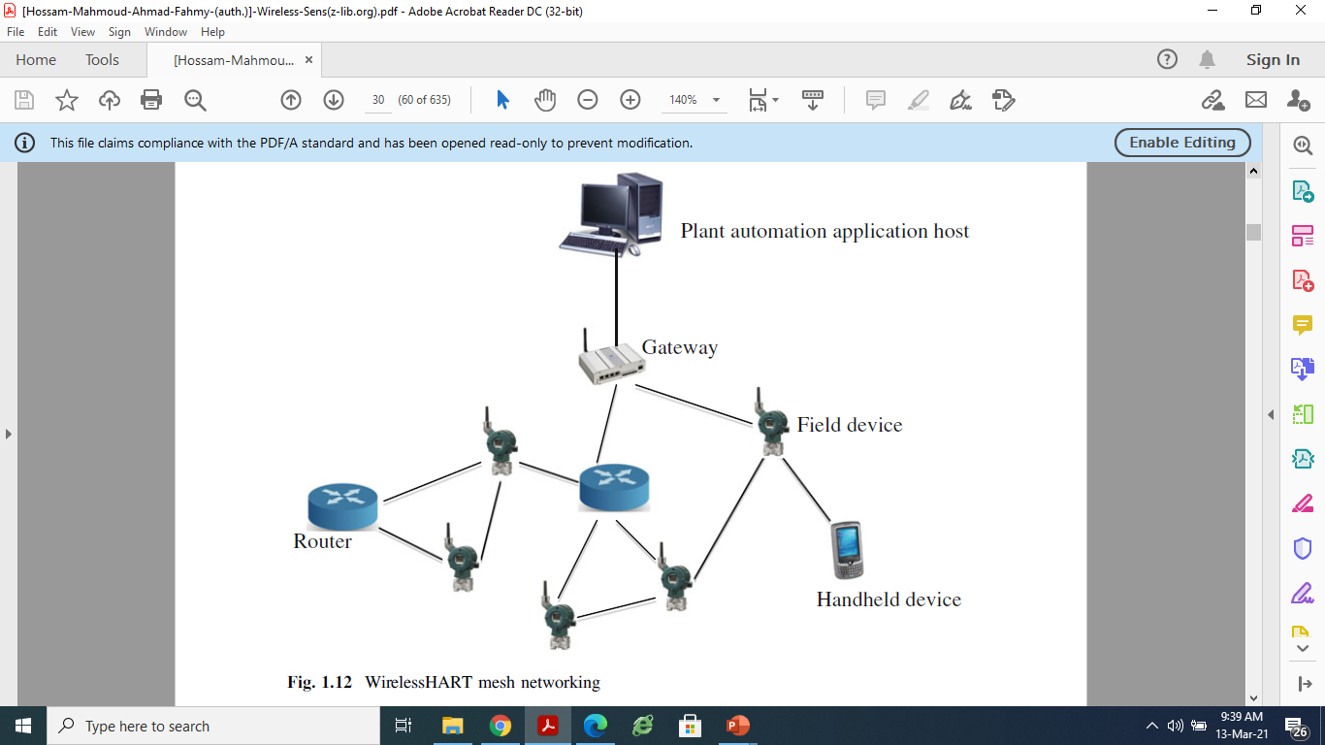
WirelessHART Mesh Networking

Slide 49
WirelessHART network consists of wireless field devices, gateways, process automation controller, host applications, and network manager:
Wireless field devices are connected to process or plant equipment.
Gateways enable the communication between the wireless field devices and the host applications.
Handheld which is a portable WirelessHART enabled computer used to configure devices, run diagnostics, and perform calibrations.
The network manager configures the network and schedule communication between devices, it also manages the routing and network traffic. The network manager can be integrated into the gateway, host application, or process automation controller.

Slide 50
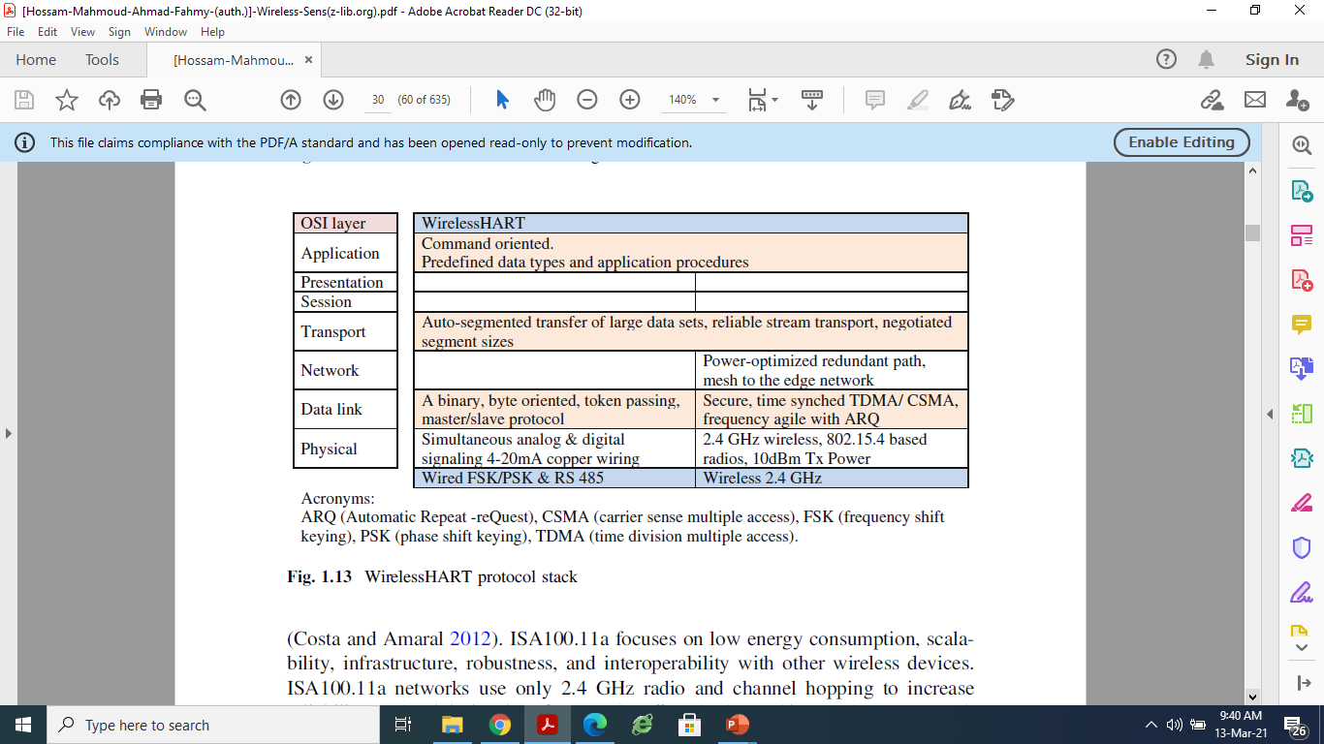
WirelessHART Protocol Stack

Slide 51
ISA 100.11a
ISA100.11a, was officially approved in September 2009 by ISA Standards and Practices Board.
It is the first standard of ISA100 family with foundations for process automation, and provisions for secure, reliable, low data rate wireless monitoring.
Specifications for the OSI layer, security, and system management are comprised (Costa and Amaral 2012). ISA100.11a focuses on low energy consumption, scalability, infrastructure, robustness, and interoperability with other wireless devices.
ISA100.11a networks use only 2.4 GHz radio and channel hopping to increase reliability and minimize interference.
It offers both meshing and star network topologies, and delivers simple, flexible, and scalable security functionality.

Slide 52
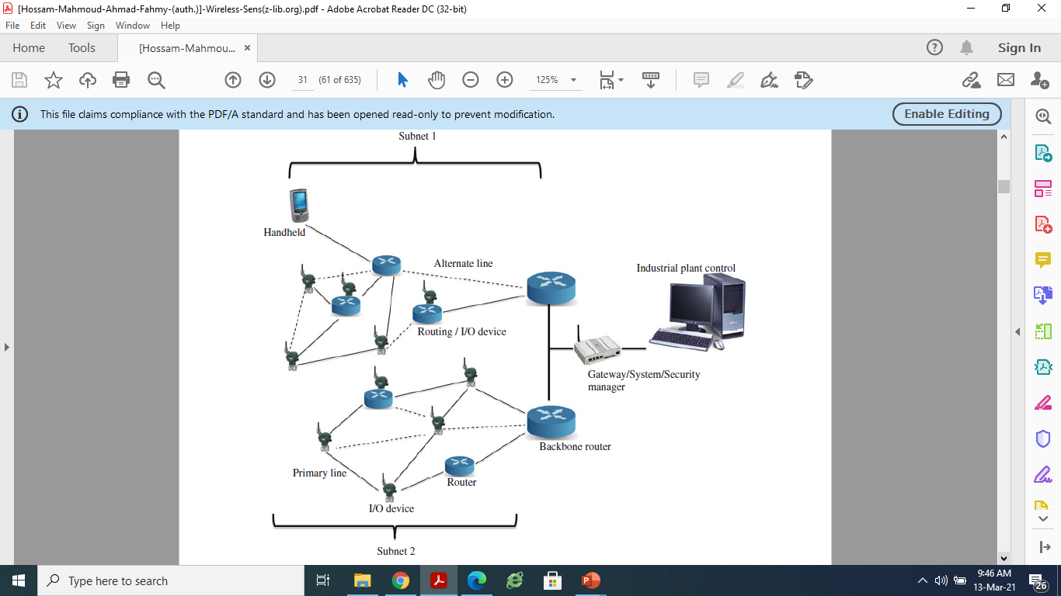
ISA 100.11a Mesh Networking

Slide 53
ISA100.11a defines for devices different role profiles that represent various functions and capabilities, such as I/O devices, routers, provisioning devices, backbone routers, gateway, system manager, security manager.
Each device may resume more than a role, while its capabilities are reported to the system manager upon joining the network:
I/O device (sensor and actuator), provides or/and consumes data, which is the basic goal of the network.
Handheld which is a portable computer used to configure devices, run diagnostics, and perform calibrations.
Router is a job accorded to devices responsible for routing data packet from source to destination and propagating clock information. A router role also enables a device to act as a proxy that permits new devices to join the network.
Device with provisioning role, for pre-configuring devices with necessary information to join a specific network.
Backbone router, routes data packets from one subnet connected to the backbone network to a destination (e.g., another subnet connected to the backbone). The backbone router is implemented with both ISA100.11a wireless network interface and backbone interface.

Slide 54
Gateway, acts as an interface between ISA100.11a field network and the host applications in the control system.
System manager, is the administrator of the ISA100.11a wireless network. It monitors the network and is in charge of system management, device management, network run-time control, and communication configuration (resource scheduling), as well as time related services.
Security manager, provides security services based on policies specified by this standard.

Slide 55
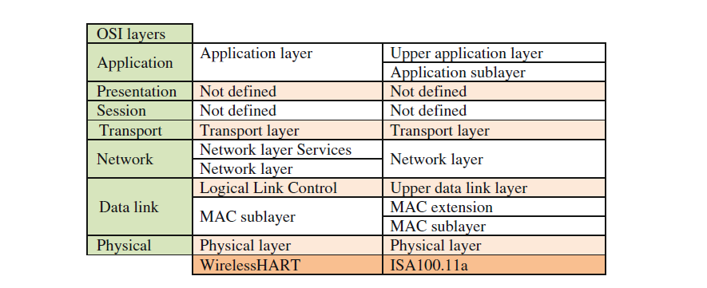
WirelessHART and ISA 100.11a Protocol Stack

Slide 56
Both WirelessHART and ISA100.11a use a simplified version of the seven-layered open systems interconnection (OSI) basic reference model.
ISA100.11a divides the DLL into a MAC sublayer, a MAC extension, and an upper DLL.
The MAC sublayer is a subset of IEEE Standard 802.15.4 MAC, with the main responsibility of sending and receiving individual data frames.
The MAC extension includes additional features not supported by IEEE Standard 802.15.4 MAC, mainly concerning changes to the carrier sense multiple access with collision avoidance (CSMA/CA) mechanisms by including additional spatial, frequency, and time diversity.
The upper DLL handles link and mesh aspects above the MAC level, and it is responsible for routing within a DL subnet.

Slide 57
6LoWPAN
IPv6-based low power wireless personal area networks (6LoWPAN) enables IPv6 packets communication over an IEEE 802.15.4 based network (Mulligan 2007;Montenegro et al. 2007; Shelby and Bormann 2011).
Low power devices can communicate directly with IP devices using IP-based protocols. Utilizing 6LoWPAN, low power devices have all the benefits of IP communication and management.
6LoWPAN standard provides an adaptation layer, new packet format and address management. Because IPv6 packet sizes are much larger than the frame size of IEEE 802.15.4, the adaptation layer is used.
The adaptation layer accomplishes header compression, which creates smaller packets fitting into the IEEE 802.15.4 frame size.
Address management mechanism handles the forming of device addresses for communication. 6LoWPAN is designed for applications with low data rate devices that require Internet communication .

Slide 58
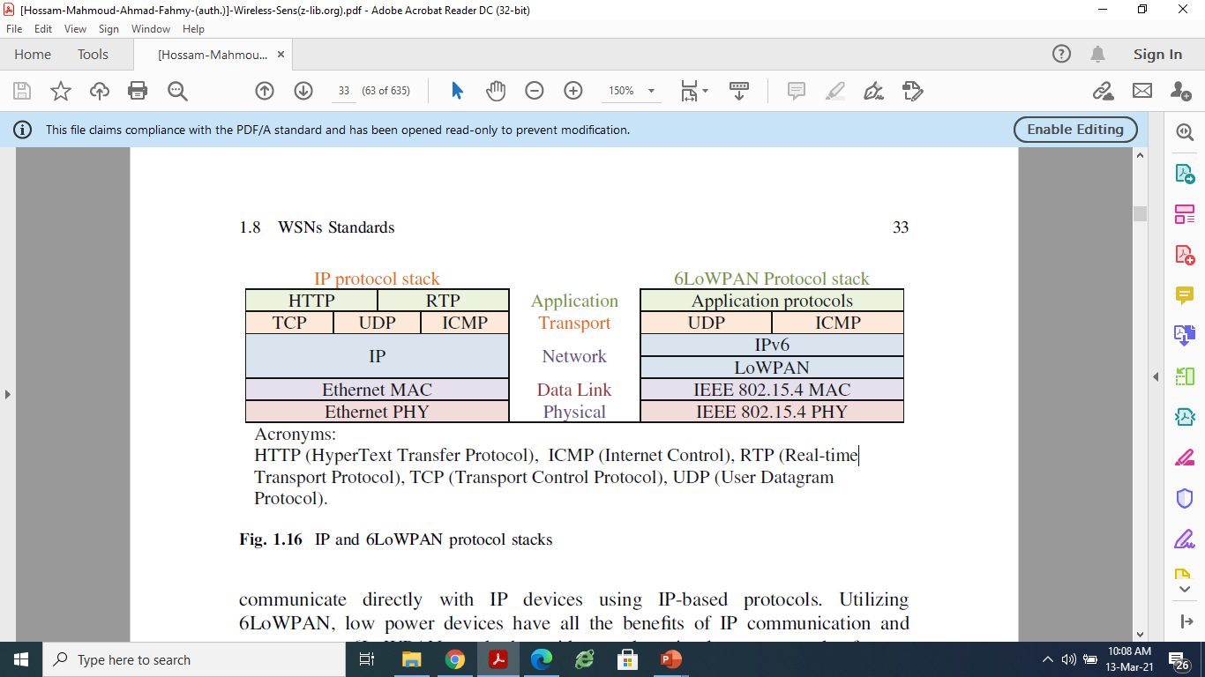
IP and 6LoWPAN Protocol Stack

Slide 59
6LoWPAN Architecture
The Wireless Embedded Internet is created by connecting networks of wireless embedded devices, each network is a stub on the Internet.
A stub network is a network where IP packets are sent from or destined to, but which does not act as a transit to other networks.
The 6LoWPAN architecture is made up of low-power wireless area networks (LoWPANs), which are IPv6 stub networks.
A LoWPAN is the collection of 6LoWPAN nodes which share a common IPv6 address prefix (the first 64 bits of an IPv6 address), meaning that regardless of where a node is in a LoWPAN its IPv6 address remains the same.

Slide 60
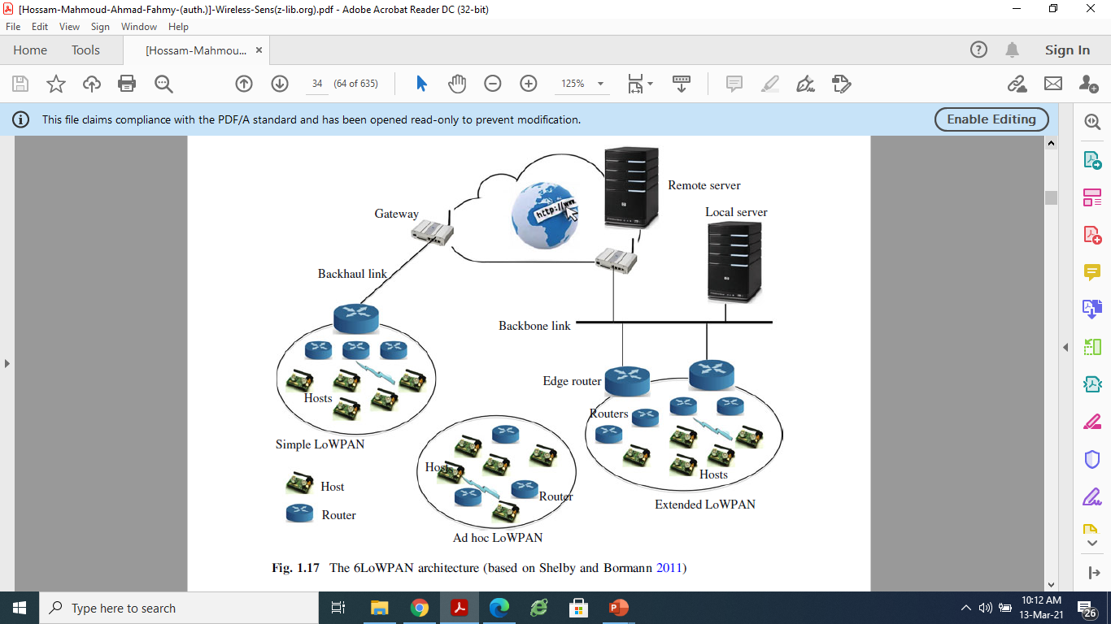
6LoWPAN Architecture

Slide 61
6LoWPAN Architecture
Three different kinds of LoWPANs have been defined :
Simple LoWPAN, connected through one LoWPAN Edge Router to another IP network. A backhaul link (point-to-point, e.g., GPRS) is shown in the figure, but it could also be a backbone link (shared).
Extended LoWPAN, that encompasses the LoWPANs of multiple edge routers via a backbone link (e.g. Ethernet) interconnecting them. Edge routers share the same IPv6 prefix and the common backbone link.
Ad hoc LoWPAN, that is not connected to the Internet, but instead operates without an infrastructure.

Slide 62
A LoWPAN consists of one or more edge router.The network interfaces of the nodes share the same IPv6 prefix distributed by the edge router and routers throughout the LoWPAN.
Each node is identified by a unique IPv6 address, and is capable of sending and receiving IPv6 packets.
In order to facilitate efficient network operation, nodes register with an edge router. LoWPAN nodes may participate in more than one LoWPAN at the same time (called multi-homing), and fault-tolerance can be achieved between edge routers.
Nodes are free to move throughout the LoWPAN, between edge routers, and even between LoWPANs. Topology change may also be caused by wireless channel conditions, without physical movements along with nodes, which may function as host or router.

Slide 63
LoWPANs are connected to other IP networks through edge routers.
The edge router plays an important role as it routes traffic in and out of the LoWPAN, while handling 6LoWPAN compression and Neighbor Discovery for the LoWPAN.
If the LoWPAN is to be connected to an IPv4 network, the edge router will also handle IPv4 interconnectivity.
Edge routers have management features tied into overall IT management solutions.
Multiple edge routers can be supported in the same LoWPAN if they share a common backbone link.

Slide 64
IEEE 802.15.3
IEEE 802.15.3 as proposed in 2003 is a MAC and PHY standard for high-rate WPANs (11−55 Mbps) (Tseng et al. 2003; IEEE 2013).
IEEE 802.15.3a was an attempt to provide a higher speed UWB PHY enhancement amendment to IEEE 802.15.3 for applications that involve imaging and multimedia.
But, the proposed PHY standard was withdrawn in 2006 as the members of the task group were not able to come to an agreement choosing between two technology proposals, multi-band orthogonal frequency division multiplexing (MB-OFDM) and direct sequence UWB (DS-UWB), backed by two different industry alliances.
The IEEE 802.15.3b-2005 amendment was released on May 5, 2006.
It enhanced 802.15.3 to improve implementation and interoperability of the MAC.
This includes minor optimizations while preserving backward compatibility.
In addition, this amendment corrected errors, clarified ambiguities, and added editorial clarifications.

Slide 65
IEEE 802.15.3
IEEE 802.15.3c-2009 was published on September 11, 2009. The IEEE 802.15.3 Task Group 3c (TG3c) was formed in March 2005.
TG3c developed a millimeter-wave-based alternative physical layer (PHY) for the existing 802.15.3 WPAN Standard 802.15.3-2003.
This millimeter-wave WPAN operates in clear band including 57–64 GHz unlicensed band defined by FCC 47 CFR 15.255.
The mmWPAN permits high coexistence (close physical spacing) with all other microwave systems in the 802.15 family of WPANs.
In addition, the mmWPAN allows very high data rate over 2 Gbps applications such as high speed internet access, streaming content download (video on demand, HDTV, home theater, etc.), real-time streaming and wireless data bus for cable replacement. Also, there are optional data rates in excess of 3 Gbps.

Slide 66
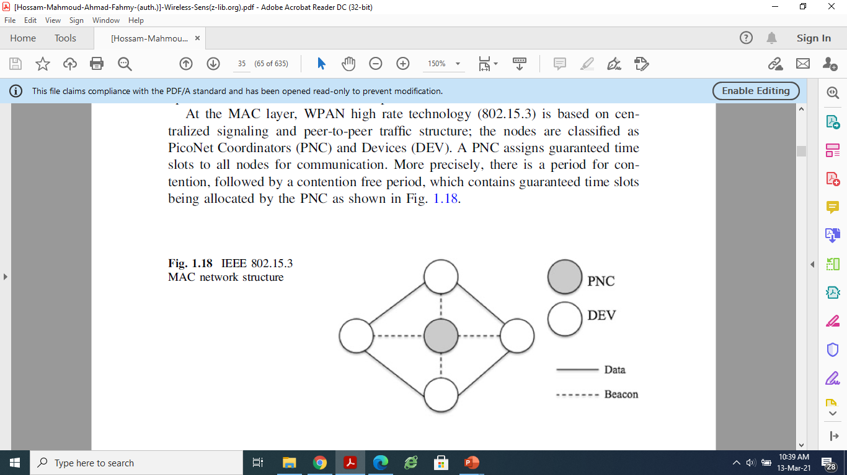
IEEE 802.15.3 MAC network structure

Slide 67
IEEE 802.15.3 MAC network structure
At the MAC layer, WPAN high rate technology (802.15.3) is based on centralized signaling and peer-to-peer traffic structure; the nodes are classified as PicoNet Coordinators (PNC) and Devices (DEV).
A PNC assigns guaranteed time slots to all nodes for communication.
More precisely, there is a period for contention, followed by a contention free period, which contains guaranteed time slots being allocated by the PNC.

Slide 68
Wibree
Wibree is a radio technology from Nokia for local connectivity between electronic devices.
Wibree is targeted for devices which have only a very limited power supply, e.g. button cell battery power, such as watches, wireless keyboards, toys and sport sensors like a heart rate monitor.
In the vision of Nokia, Wibree is complementary to Bluetooth.
Wibree can only be used over rather short ranges of typical 5 m up to 10 meters maximum, Wibree operates in the 2.4 GHz band.

Slide 69
Wibree
Wibree may be deployed on a stand-alone chip or on a dual-mode chip along with conventional Bluetooth, it works with Bluetooth to make devices smaller and more energy-efficient. Bluetooth–Wibree utilizes the existing Bluetooth RF and enables ultra-low power consumption.

Slide 70
Wibree
Wibree transmits data more slowly than Bluetooth -- up to 1 megabit per second, compared to Bluetooth's 3 megabits per second.
It has the merits like the wibree technology consumes low power, has long battery life, tiny chip size, it is very much energy efficient than the Bluetooth technology, the implementation of wibree is affordable and it can be easily embedded with the Bluetooth solutions.
The disadvantages of wibree are as follows:
1. It has the slow data transmission.
2. This technology cannot be used in the high bandwidth applications.

Slide 71
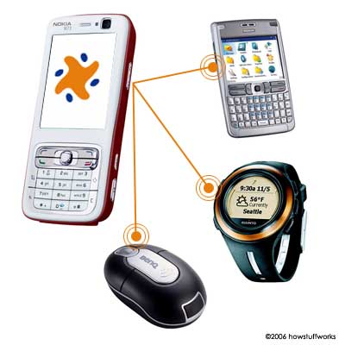
Wibree is “up to 10 times more energy efficient than Bluetooth

Slide 72
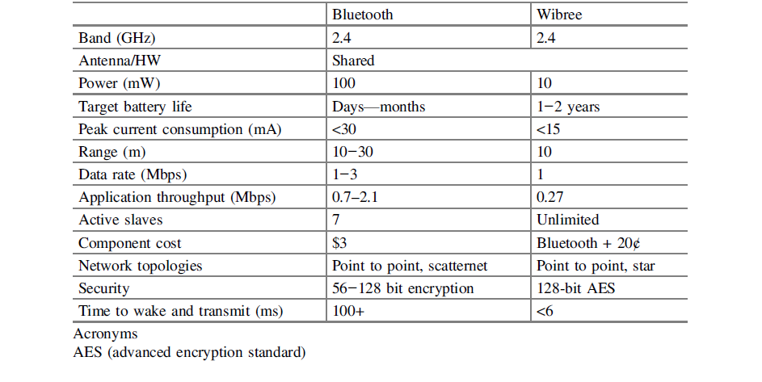

Slide 73
BLE (Bluetooth Low Energy )
BLE is a form of wireless communication designed especially for short-range communication.
Most smartphones and tablets today are BLE compatible, which means they can seamlessly communicate with Bluetooth enabled wireless headphones, car stereos, fitness trackers, smart watches and hardware devices like beacons.
BLE data transfer is essentially a one-way communication.
Classic Bluetooth is great for applications that require continuous streaming of data, for example, headphones. However, BLE is suited for applications that work well with a periodic transfer of data, and hence reduces a significant amount of battery usage. This makes BLE suitable for IoT and proximity marketing-related applications.

Slide 74
What is a Bluetooth Low Energy (BLE) beacon?
BLE beacons, as the name suggests are beacons that communicate via Bluetooth Low Energy. Beacons are small radio transmitters, strategically mounted throughout locations, to broadcast BLE signals in a given range. This range depends on the hardware capability. On an average, a Bluetooth Low Energy beacon can transmit BLE signals to 80 meters.

Slide 75
How is BLE technology used with beacons?
Beacons send out an ID number via BLE channels, approximately 10 times every second. A Bluetooth-enabled device in proximity of the beacon picks up this ID number. When an app or pre-installed service like Google Nearby recognizes the ID number, it links it to an action, such as download an app, or piece of content (maybe a marketing offer) stored on the cloud, and displays it on the smartphone.

Slide 76
key point must be taken into consideration, BLE is incompatible with standard Bluetooth, BLE devices do not interoperate with classical Bluetooth products.
However, implementing a dual-mode device could achieve such interoperability.
A dual-mode device is an integrated circuit that includes both a standard Bluetooth radio and a BLE radio, each mode operates separately, not at the same time, though they can share an antenna.
Several vendors offer dual mode chips, such as Broadcom, CSR, EM Microelectronics, Nordic Semiconductor, and Texas Instruments.
Complete modules also are available from connect Blue (Frenzel 2012).

Slide 77
Z-Wave
Z-Wave, a proprietary technology developed by Zensys A/S of Denmark, is focusing exclusively on the residential market (Reinisch et al. 2007; Z-Wave Alliance 2012).
The two wireless networking standards, Z-Wave and ZigBee, are competing to become the standard for automated home control.
Z-Wave is a wireless communications protocol used primarily for home automation.
It is a mesh network using low-energy radio waves to communicate from appliance to appliance
Allowing for wireless control of residential appliances and other devices, such as lighting control, security systems, thermostats, windows, locks and garage door openers.
Z-Wave system can be controlled via the Internet from a smart phone, tablet or computer, and locally through a smart speaker.

Slide 78
Interoperability of Z-wave
Z-Wave's interoperability at the application layer ensures that devices can share information and allows all Z-Wave hardware and software to work together.
Its wireless mesh networking technology enables any node to talk to adjacent nodes directly or indirectly, controlling any additional nodes.

Slide 79
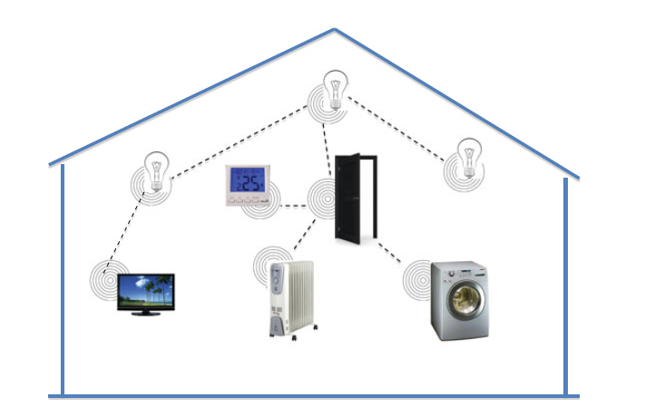
Z Wave for Home Control

Slide 80
Technical Features of Z-Wave
Z Wave is designed to provide reliable, low-latency transmission of small data packets at data rates up to 100kbit/s
Z-Wave uses the unlicensed industrial, scientific, and medical ISM band. It operates at 868.42 MHz in Europe, at 908.42 MHz in the North America and uses other frequencies in other countries depending on their regulations.
Z-Wave uses a source-routed mesh network architecture.
Mesh networks are also known as wireless ad hoc networks.
In such networks, devices use the wireless channel to send control messages which are then relayed by neighboring devices in a wave-like fashion.

Slide 81
Each Z-Wave network is identified by a Network ID, and each device is further identified by a Node ID.
The Network ID has a length of 4 bytes (32 bits) and is assigned to each device, by the primary controller.
The Node ID has a length of 1 byte (8 bits) and must be unique in its network.
On November 17, 2016, the Z-Wave Alliance announced stronger security standards for devices receiving Z-Wave Certification as of April 2, 2017, Known as Security 2 .
It shores up encryption standards for transmissions between nodes, and mandates new pairing procedures for each device, with unique PIN or QR codes on each device.
Z-Wave has a long open-air operating range at 90 meter (outdoor) and 24+ meter(indoor).

Slide 82
Z-Wave defines two types of devices, controllers and slaves.
Controller's poll or send commands to the slaves, which reply to the controllers or execute the commands.
The Z-Wave routing layer performs routing based on a source routing approach.
When a controller transmits a packet, it includes the path to be followed in the packet. A packet can be transmitted over up to four hops, which is sufficient in a residential scenario and hard-limits the source routing packet overhead.
A controller maintains a table that represents the full topology of the network.
A portable controller (e.g., a remote control) tries first to reach the destination via direct transmission; if that option fails, the controller estimates its location and calculates the best route to the destination.
Slaves may act as routers, routing slaves store static routes (typically toward controllers) and are allowed to send messages to other nodes without being requested to do so.
Slaves are suitable to be monitoring sensors where the delay contributed by polling is acceptable, as well as for actuators that perform actions in response to activation commands.
Routing slaves are used for time critical and non solicited transmission applications such as alarm activation.

Slide 83
Insteon
Insteon is the network technology that brings fast, reliable and affordable automation to your home.
It enables light switches, lights, thermostats, leak sensors, remote controls, motion sensors, and other electrically powered devices to interoperate through power lines, radio frequency (RF) communications, or both.
It employs a dual-mesh networking topology in which all devices are peers and each device independently transmits, receives, and repeats messages.
Like other home automation systems, it has been associated with the Internet of Things.

Slide 84
Protocol for Insteon
Every message received by an Insteon compatible device undergoes error detection and correction and is then retransmitted to improve reliability.
All devices retransmit the same message simultaneously so that message transmissions are synchronous to the power line frequency, thus preserving the integrity of the message while strengthening the signal on the power line and erasing RF dead zones.
Insteon power line messaging uses phase-shift keying. Insteon RF messaging uses frequency-shift keying.

Slide 85
Network Topology for Insteon
Insteon is an integrated dual-mesh (formerly referred to as "dual-band") network that combines wireless radio frequency (RF) and a building's existing electrical wiring. The electrical wiring becomes a backup transmission medium in the event of RF/wireless interference. Conversely, RF/wireless becomes a backup transmission medium in the event of power line interference.
As a peer-to-peer network, devices do not require network supervision, thus allowing optional operation without central controllers.
There's no practical limit to the size of an Insteon network. Installations often have more than 400 devices - one installation has nearly 2,000 devices, all working flawlessly together with no delays of less than 0.05 seconds.

Slide 86
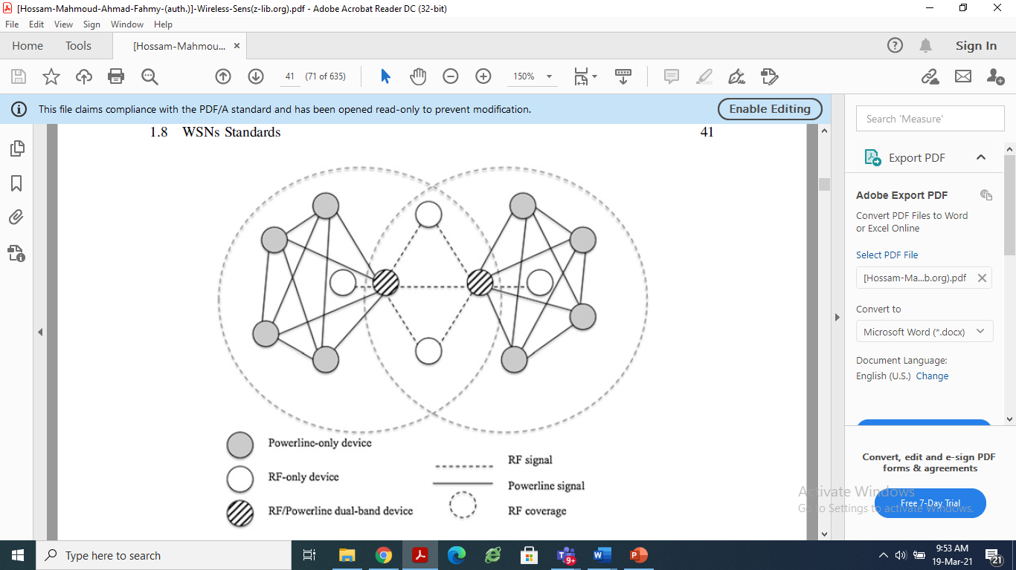
Insteon Networking

Slide 87
Features of INSTEON Networking
INSTEON devices are peers, which means that any of them can play the role of sender, receiver, or relayer.
Communication between devices that are not within the same range is achieved by means of a multi-hop approach that differs in many aspects from traditional techniques. All devices retransmit the messages they receive, unless they are the destination of the messages. The maximum number of hops for each message is limited to four (as in Z-Wave). The multi-hop transmission is performed using a time slot synchronization scheme, by which transmissions are permitted in certain time slots, and devices within the same range do not transmit different messages at the same time. These time slots are defined by a number of power line zero crossings.

Slide 88
Features of INSTEON Networking
RF devices that are not attached to the power line can transmit asynchronously, but RF devices attached to the power line will retransmit the related messages synchronously.
In contrast to classical collision avoidance mechanisms, devices within the same range are allowed to transmit the same message simultaneously. This approach,which is called simulcast, relies on the very low probability of multiple simultaneous signals being cancelled at the receiver.

Slide 89
ANT (Adaptive Network Topology)
ANT is a proprietary technology featuring a wireless communication protocol stack thought for ultra-low power networking applications (ANT 2013).
It is designed to run using low cost, low power micro-controllers and transceivers operating in the 2.4 GHz ISM band.
The ANT WSN protocol has been engineered for simplicity and efficiency, resulting in ultra low power consumption, maximized battery life, a minimal burden on system resources, simpler network designs and lower implementation costs.
ANT also features low latency, ability to trade-off data rate against power consumption, support for broadcast, burst and acknowledged transactions up to a net data rate of 20 Kbps (ANT’s over the air data rate is 1 Mbps).

Slide 90
ANT (Adaptive Network Topology)
ANT (Adaptive Network Topology) is a proprietary , but open access multicast wireless sensor network technology primarily used for sports and fitness sensors.
It is conceptually similar to Bluetooth low energy, but is oriented towards usage with sensors.
ANT-powered nodes are capable of acting as slaves or masters within a wireless sensor network concurrently.
In addition, every node is capable of determining when to transmit based on the activity of its neighbors.
ANT accommodates three types of messaging: broadcast, acknowledged, and burst (a multi-message transmission)

Slide 91
ANT posses excellent interference immunity.
With millions of deployed nodes, ANT is perfectly suited for any kind of low data rate sensor network topologies - from peer- to-peer or star, to practical mesh - in personal area networks (PAN) which are well suited for sports, fitness, wellness and home health applications.

Slide 92
ANT
Different topologies could be established, peer-to-peer, star, tree and other types of mesh network.
ANT nodes are capable of acting as slaves or masters within a network and swapping roles at any time. This means that the nodes can act as transmitters, receivers or transceivers to route traffic to other nodes.
ANT is a good protocol for practical networks because of this inherent ability to support ad hoc interconnection of tens or hundreds of nodes.
ANT allows a system to spend most of its time in an ultra low power sleep mode, wake up quickly, transmit for the shortest possible time and quickly return back to an ultra-low power sleep mode.
This implies that ANT is one of the energy-efficient available technologies.

Slide 93
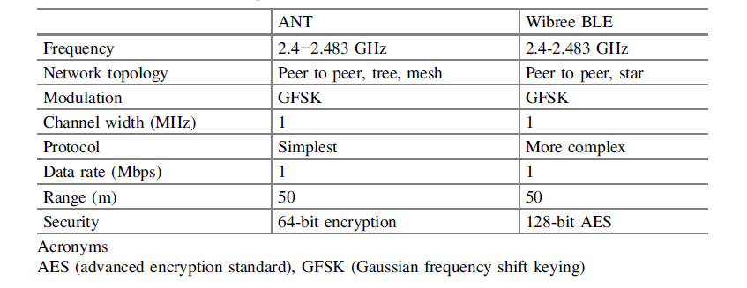
ANT and BLE Comparision

Slide 94
Wavenis
Wavenis is a wireless protocol stack developed by Coronis Systems for control and monitoring applications in several environments, including home and building automation (Gomez and Paradells 2010).
Wavenis is currently being promoted and managed by the Wavenis Open Standard Alliance (Wavenis-OSA). It defines the functionality of physical, link, and network layers.
Wavenis services can be accessed from upper layers through an application programming interface (API).

Slide 95
Wavenis
Wavenis is a wireless technology developed for ultra low power and long range Wireless Sensor Networks(WSNs).
It has number of applications in smart grid sector such as telemetry, automatic metric reading, utility metering, long-range UHF RFID applications etc.
Wavenis system is used in variety of mesh networks from simple point to point connections to advanced tree structure consisting of multiple repeaters.
For example a simple lighting control system as well as point to point wireless remote reading system. The system consists of switches and lights in Point to Point or point to multipoint lighting system.

Slide 96
Wavenis wireless technology is the solution on the market to offer the optimal trade-off of the key features as
Multiple years battery life (ultra-low power consumption)
Connections up to hundreds of yards
Deployment in hard-to-reach places
Low traffic & Small amounts of data transfer
Robustness against physical and electrical interference
Openness to WAN and complementary wireless technologies

Slide 97
Technical Specifications
Wavenis operates mainly in the 433 MHz, 868 MHz, and 915 MHz bands, which are ISM bands in Asia, Europe, and the United States. Some products also operate in the 2.4 GHz band.
The minimum and maximum data rates offered by Wavenis are 4.8 Kbps and 100 Kbps, respectively, with 19.2 Kbps being the typical value.
Data are modulated using Gaussian FSK (GFSK). Fast frequency-hopping spread spectrum (FHSS) is used over 50 kHz bandwidth channels.
The Wavenis MAC sublayer offers synchronized and non-synchronized schemes:

Slide 98
In a synchronized network, nodes are provided with a mixed CSMA/TDMA mechanism for transmitting in response to a broadcast or multicast message. In such a case, a node allocates a time slot that is pseudo-randomly calculated, based on its address. Before transmission in that slot, the node performs carrier sense (CS). If the channel is busy, the node computes a new time slot for the transmission.
For non-synchronized networks, in applications where reliability is a critical requirement (alarms, security, etc.), CSMA/CA is used. The Wavenis logical link control (LLC) sublayer manages flow and error control by offering per-frame or per-window ACKs.

Slide 99
Wavenis defines only one type of device.
The Wavenis network layer specifies a four-level virtual hierarchical tree.
The root of the tree may play the role of a data collection sink or a gateway. A device that joins a Wavenis network intends to find an adequate parent, for this purpose, the new device broadcasts a request for a device of a certain level and a sufficient quality of service (QoS) value.
The QoS value is obtained by taking into consideration parameters such as received signal strength indicator (RSSI) measurements, battery energy, and the number of devices that are already attached to this device.

